Slide 1
NON-PHARMACOLOGICAL ANALGESIC METHODS IN LABOR
بنام خدا
Dr Movassaghi

Slide 2
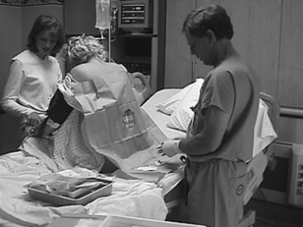
METHODS OF PAIN RELIEF
NON-PHARMACOLOGICAL METHODS
PHARMACOLOGICAL METHODS

Slide 3
Nonpharmacologic Analgesic Techniques
Minimal Training/Equipment
Emotional support
Touch and massage
Therapeutic use of heat and cold
Hydrotherapy
Vertical position
Specialized Training/Equipment
Biofeedback
Intradermal water injection
Transcutaneous electrical nerve stimulation (TENS)
Acupuncture
Hypnosis

Slide 4
Goals of Childbirth Preparation
Patient education about pregnancy, labor, and delivery
Relaxation training
Instruction in breathing techniques
Participation of father/support person
Early parental bondin

Slide 5
Purported Benefits of Childbirth Preparation
Greater maternal control and cooperation
Decreased maternal anxiety
Reduced maternal pain
Decreased maternal need for analgesia/ anesthesia
Shorter labor
Diminished maternal morbidity
Less fetal stress/distress
Strengthened family relationships as a result of the shared birth experience

Slide 6
NON-PHARMACOLOGICAL METHODS
ADVANTAGES—Drugs administered may cross the placenta and depress the fetus.

Slide 7
Continuous Labor Support
Continuous support during labor is essential to the process of a satisfying childbirth experience; typically, the parturient’s husband or friend provides this support.
This support appears most helpful for the parturient who lives in a stable family unit.
Others have found that emotional support provided by unfamiliar trained individuals (e.g., doulas) also has a positive effect

Slide 8
Touch and Massage
touch and massage provide a comfort that is appreciated by women during labor.
These measures may be used by the parturient, her support person, or the professional staff members providing intrapartum care.

Slide 9

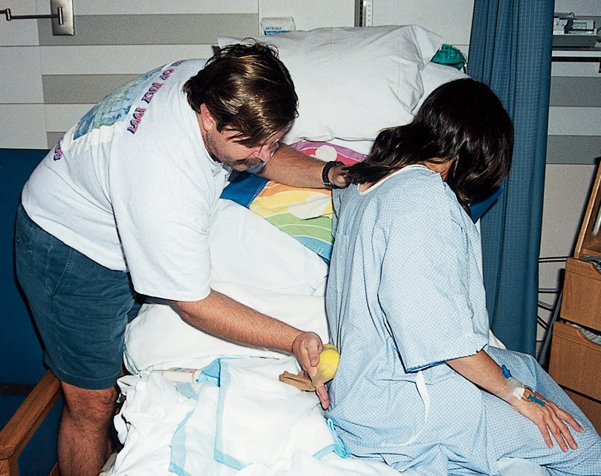
Skin Stimulation

Slide 10
Therapeutic Use of Heat and Cold
Warm compresses may be placed on localized areas, or a warm blanket may cover the entire body.
Alternatively, ice packs may be placed on the low back or perineum to decrease pain perception.

Slide 11
Hydrotherapy
Hydrotherapy may involve a simple shower or tub bath or
may include the use of a whirlpool or large tub specially equipped for pregnant women .
Purported benefits of hydrotherapy include decreased anxiety and pain and greater uterine contraction efficiency.

Slide 12
Vertical Position
A number of studies have assessed maternal position during the second stage of labor.
There is renewed interesting the squatting or modified squatting position and its greater comfort for some women during childbirth.
Some studies have evaluated the use of a birth chair to facilitate delivery in the sitting position.
These studies noted no difference in length of the second stage, mode of delivery, occurrence of perineal trauma, or Apgar scores in parturients .
less severe pain and a lower rate of perineal trauma may be associated with giving birth in the upright position; however, blood loss may be greater

Slide 13
Biofeedback
Biofeedback is a relaxation method that is used as an adjunct to the relaxation training taught in Lamaze classes and other childbirth education programs.
Two biofeedback procedures may be applicable to the laboring woman: skin-conductance (autonomic) and electromyographic (voluntary muscle) relaxation.

Slide 14
Intradermal Water Injections
Intradermal or intracutaneous water injections are used to treat lower back pain, which is a common complaint durin g labor.
The afferent nerve fibers that innervate the uterus and cervix, as well as the nerve fibers that innervate the lower back, all enter the spinal cord at the T10 through L1 spinal segments
The technique consists of injecting 0.05 to 0.1 mL of sterile water, with an insulin or tuberculin syringe, at four sites on the lower back (i.e., over each posterior superior iliac spine, and at 1 cm medial and 3 cm caudad to the posterior superior iliac spine on both sides of the back, for a total of four injections.
The analgesic effect appears to last for 45 to 120 minutes

Slide 15
Transcutaneous Electrical Nerve Stimulation (TENS)
Transcutaneous electrical nerve stimulation (TENS) involves the transmission of low-voltage electrical current to the skin via surface electrodes .
use of TENS at specific points and observed a reduction in pain perception more commonly in the study group than in the control group.
Advantages of TENS are that it is easy to use and is continue, is noninvasive, and has no demonstrable harmful effects on the fetus.

Slide 16
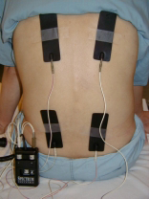
(TENS)
The only stated disadvantage is the occasional interference with electronic fetal heart rate monitoring.

Slide 17
Acupuncture/Acupressure
Traditional Chinese medicine includes extensive use of acupuncture.Given that acupuncture can provide analgesia, there is interest in its use for intrapartum Analgesia, although this is not a traditional use of the method .
A randomized, controlled trial of acupressure (treatment) compared with touch (control) at the SP6 acupoint found lower pain scores and a shorter duration of labor in the acupressure group .

Slide 18
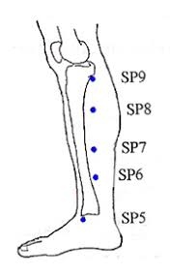
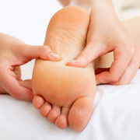
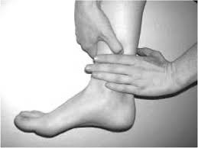
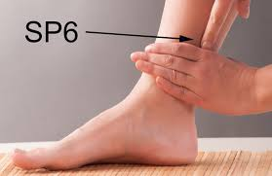
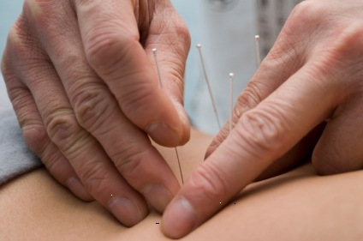
SP6 acupoint

Slide 19
Hypnosis
The use of hypnosis for obstetric analgesia is not new
safety for the mother and the fetus, lower analgesic requirements, and shorter labor as the major advantages of intrapartum hypnosis .
Instruction in the techniques of self-hypnosis before the onset of labor or, alternatively, availability of the hypnotist during labor is time consuming for the hypnotist .
successful hypnosis training should begin early in the third trimester

Slide 20

از توجه شما متشكرم
دكتر موثقي

